Slide 1
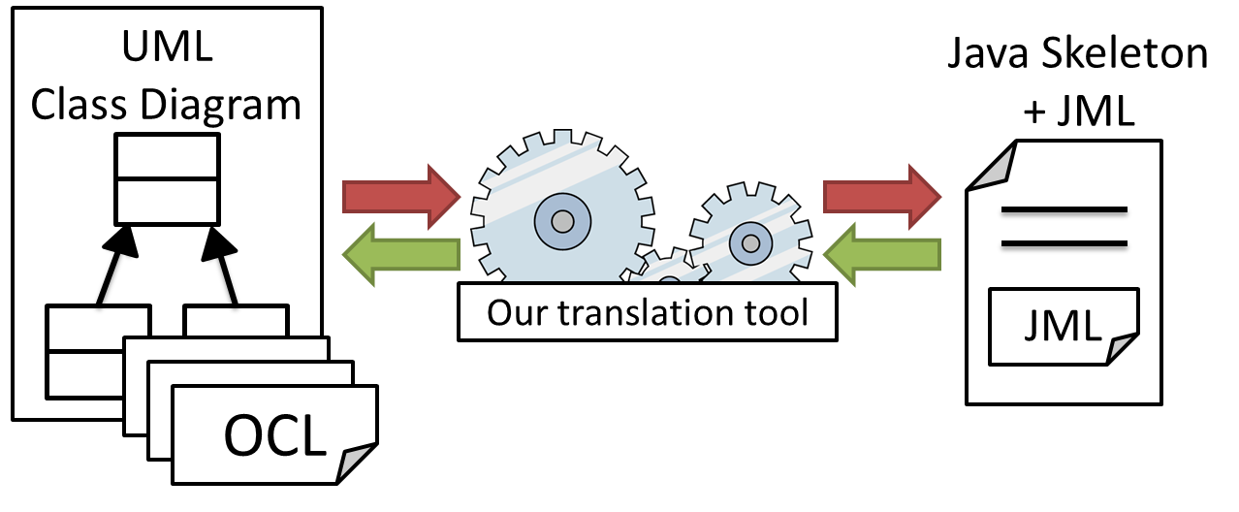
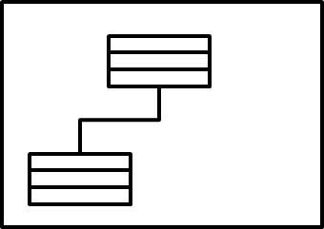
Bidirectional Translation between OCL and JML for Round-trip Engineering
Hiroaki Shimba, Kozo Okano, Shinji Kusumoto
Graduate School of Information Science and Technology, Osaka University
Abstract
Contribution
OCL (Object Constraint Language)
Our implemented tool enables a user to maintain consistency of specification between design and implementation
The experimental results highlights the benefits of our translation approach
OCL is used to describe properties of UML models
UML diagram alone cannot express rich semantics
It is standardized by OMG (Object Management Group)
OCL can describe constraints of the following types
Pre-conditions, Post-conditions, Class invariants
Account
Research Goal
balance : Integer
By bi-translation tool, we can support RTE in order to increase reliability of software development
The tool supports development in static design (UML class diagram…)
If developers combine the tool and other existing RTE support tool of dynamic design (UML activity diagram…), reliability of software development can further increase
deposit (val : Integer) : void
Context Account
inv : balance > 0
Context Account :: deposit (val : Integer): void
pre : val > 0
post : balance = balance@pre + val
Challenges
class Sample{
/*@ invariant (b1&& !b2)||(!b1&&b2); @*/
boolean b1,b2;
…
/*@ ensures !(\result == null); @*/
public String method1(){
}
}
Forms of statements may change by retranslation from JML to OCL
inv : b1 xor b2
inv : (not b1 and b2
or (b1 and not b2)
post : result.oclIsUndefined()
JML (Java Modeling Language)
JML is used to describe properties of classes and methods
JML can describe constraints just like OCL
Pre-conditions, Post-conditions, Class invariants
Approach
Class Account{
/*@ invariant balance > 0; @*/
int balance;
/*@ requires val > 0; @*/
/*@ ensures balance == \old(balance) + val @*/
public void deposit(int val){
}
}
Embedding original OCL statements and hash code of generated JML statements in the comment area
class Sample{
//Original_OCL={inv : b1 xor b2},
JML_HashCode={1006362589};
/*@ invariant
(b1&& !b2)||(!b1&&b2); @*/
boolean b1,b2;
…
//Original_OCL=
{post : result.oclIsUndefined()},
JML_HashCode={1873453796};
/*@ ensures !(\result == null); @*/
/*@ ensures \result == null; @*/
public String method1(){
}
…
}
Annotation
inv : b1 xor b2
post : result.oclIsUndefined()
post : not result.oclIsUndefined()
Round-trip Engineering
Static models
RTE is a method that gradually refines models and source code by applying forward engineering and reverse engineering
Java skeleton code
Static model(class diagram)
Auto
generation
class Account{
int balance;
…
public void deposit(int val){
}
…
}
…
Account
Comparing hash code of target statement with embedded hash code
balance : Integer
Output embedded OCL statement (equal)
Normally translate target stement (not equal)
deposit (val : Integer) : void
Auto
generation
Experiment of our tool
Input JML
Targets are nine real projects
In order to evaluate availability of our tool, we conducted the experiment
Two projects are developed by our past research
Input : JML statements in each projects
OCL
compare
Seven projects are open source projects
Step1 : translation from JML to OCL
generated JML
All projects have JML statements
Step2 : translation from OCL generated in Step1 to JML
JML:
number of input JML statements
Success num:
number of statements that translation success in translation from JML to OCL
OCL:
number of input OCL statements that is
generated in Step1
Semantic num:
number of statements which are semantically equivalent between input JML and generated JML
Syntactic num:
number of statements which are syntactically
equivalent between input JML and generated JML
Translation from JML to OCL
Translation from generated OCL to JML
 | JML | Success num | Success ratio
Warehouse management | 142 | 142 | 100%
Educational affairs | 468 | 444 | 95%
PokerTop | 113 | 113 | 100%
101JMLSpecifications | 30 | 30 | 100%
consultorOrtografico | 124 | 84 | 68%
Zinara | 128 | 106 | 83%
Lenguajes_III | 65 | 65 | 100%
P2-master | 56 | 56 | 100%
extweka | 233 | 230 | 99%
total | 1359 | 1270 | 94%
 | OCL | Semantic Num | Semantic ratio | Syntactic num | Sytactic ratio
Warehouse management | 142 | 142 | 100% | 62 | 44%
Educational affairs | 444 | 444 | 100% | 214 | 48%
PokerTop | 113 | 103 | 91% | 74 | 66%
101JMLSpecifications | 30 | 26 | 87% | 9 | 30%
consultorOrtografico | 84 | 82 | 98% | 63 | 75%
Zinara | 106 | 96 | 91% | 36 | 34%
Lenguajes_III | 65 | 65 | 100% | 0 | 0%
P2-master | 56 | 30 | 54% | 18 | 32%
extweka | 230 | 200 | 87% | 115 | 50%
total | 1270 | 1188 | 94% | 591 | 47%
Successful ratio is as high as 94%
Out tool is practical so that translation time is few seconds
Semantic ratio is as high as 94%
Syntactic ratio is not as high as 47%
KUSUMOTO LABORATORY - Software Design Laboratory
Department of Computer Science, Graduate School of Information Science and Technology, Osaka University. http://sdl.ist.osaka-u.ac.jp/

